Slide 1
Model Evaluation
Model: Red wine rating Machine Learning Model

Slide 2
Section: List Comparisons

Slide 3
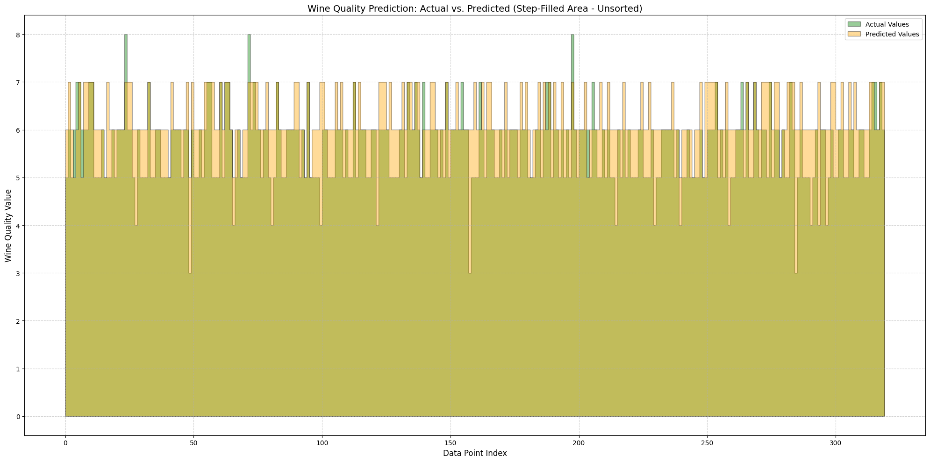
Literal List Comparison

Slide 4
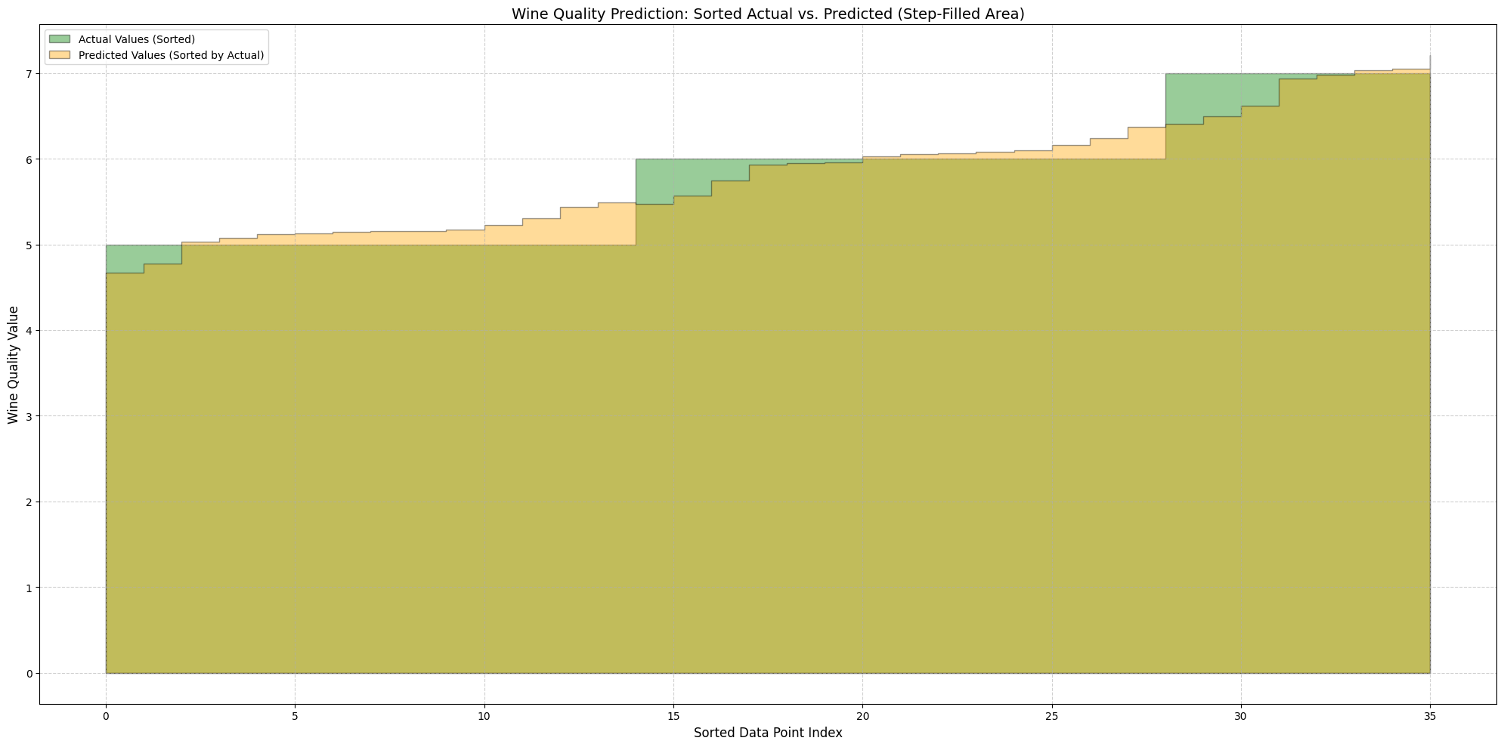
Sorted List Comparison

Slide 5
Section: Subplots Grouped by Actual Value

Slide 6
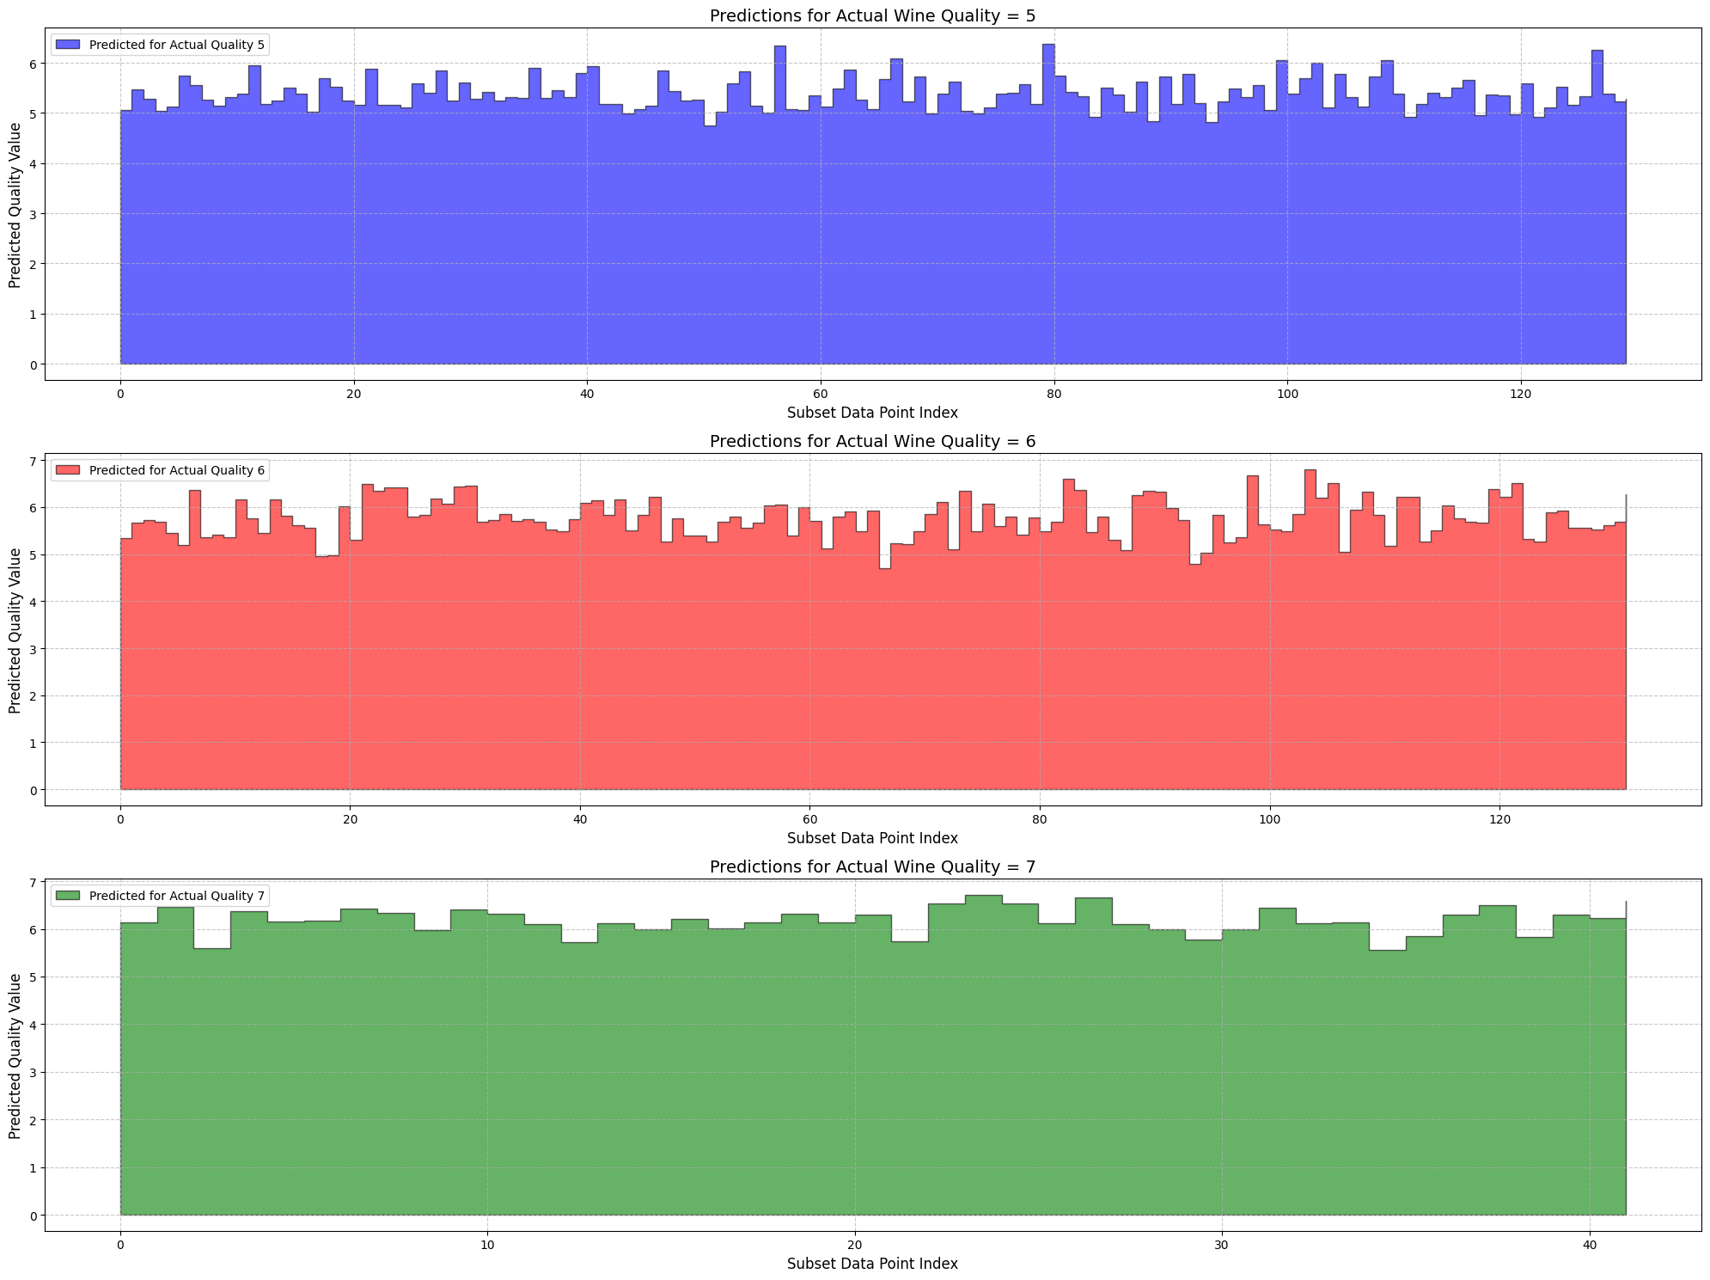
Graph

Slide 7
Per Value Statistics
--- Prediction Statistics Grouped by Actual Quality ---
Actual Quality 5: Mean of Predictions: 5.383
Mean Absolute Deviation (MAD) of Predictions: 0.256
Actual Quality 6:
Mean of Predictions: 5.757
Mean Absolute Deviation (MAD) of Predictions: 0.341
Actual Quality 7: Mean of Predictions: 6.176
Mean Absolute Deviation (MAD) of Predictions: 0.217
--- End of Analysis ---

Slide 8
Section: Overall Statistics

Slide 9
Statistics
--- Overall Model Metrics ---
Overall Mean of Predictions: 5.651
Overall Mean Absolute Deviation (MAD) of Predictions: 0.394
Overall R-squared (Coefficient of Determination): 0.403
Overall Mean Absolute Error (MAE): 0.504
--- End of Overall Analysis ---

